Slide 1
Group : 1
LOU Shangzhi CHEREL Bastien
Insurance Review Analysis

Slide 2
Example of a table of contents
1 | General presentation of the project and data
1.1 | Presentation of the problem
1.2 | Data presentation
1.3 | Data exploration and cleansing
3 | Feature engineering and modelling
2.1 | Creating new variables
2.2 | Building and comparing predictive models
4 | Interpretation of results
3.1 Importance of variables
3.3 | Conclusion on the use of models

Slide 3
Purpose and context
Context :
Customer satisfaction surveys have been carried out, and an analysis of open comments has been carried out.
Objectives:
Identifying themes in comments
Understanding the impact of themes on customer satisfaction levels
Techniques used :
Carrying out an exploratory analysis
identify themes

Slide 4
1
Presentation of the project's objective and data
General file structure
Presentation of variables
Analysis/presentation of target variables
Presentation of explanatory variables/features/input

Slide 5
1.1
Objective and context
Objectives
Understanding products and insurers and their average ratings
Viewing changes in scores over time

Slide 6
Presentation of the objective
Non-technical presentation: objective, usefulness,
Technical presentation:
Projet 2 :
Examples of NLP issues using the Open Food Facts database
Segmenting products with ingredients
Apply word2vec to ingredients: display similar ingredients
Apply global average pooling for products, and search for similar products

Slide 7
1.2
Data presentation
Objectives
Understanding products and insurers and their average ratings
Viewing changes in scores over time

Slide 8
Data presentation
Variables
Context of publication of notices (author, date of publication)
Context of the insurance product (type of product, insurer)
Customer reviews
Translation of the notice into English
Related note
Present the data in categorical macro format (in a pyramid) to make it clear.
Describe some anomalies and their causes

Slide 9
Data presentation (project 1)
Variables
text
hotel (id and name)
rating (“service”, “cleanliness”, “overall”, “value”, “location”, “sleep quality”, “rooms”)
Present the data in categorical macro format (in a pyramid) to make it clear.
number of hotels
average rating (distribution, density or histogram)
average text length (distribution, density or histogram)

Slide 10
Metrics used
Metrics (average, density) before cleaning
Metric after cleaning
Count the number of lines deleted and the reasons why

Slide 11
2
Exploration/Transformation/
feature engineering
Data cleansing
Simple exploration and cleaning
Word embedding (self-supervised)
Other NLP tasks

Slide 12
2.1
Data cleaning
Objectives
Understanding products and insurers and their average ratings
Viewing changes in scores over time

Slide 13
Summary of cleaning work carried out
Restatement of dates
Removal of notices with missing text
Text cleaning
Removing stop words (empty words)
Deleting special characters
Replacement of certain words ("customer service" by "customer_service", study to find bigrams or trigrams).
Export the cleaned file so that you don't have to do it again for future sessions. This file must contain the following columns
Date of publication of the notice
Month of experience (first day of the month)
Notice in French without cleaning
Notice in French with cleaning 1 for certain models
Avis en français avec nettoyage 2 pour d'autres modèles
The same applies to notices translated into English

Slide 14
2.2
Data mining
Objectives
Understanding products and insurers and their average ratings
Viewing changes in scores over time

Slide 15
Global data mining
Number of reviews and average rating by product, insurer, date, etc.
Number of words in a notice, depending on the rating
Create models by product if necessary following exploration

Slide 16
Exploring opinions
Count and average score (and how they change over time) as a function of the following variables
Product
Insurer
As far as comments are concerned, we need to analyse them on a product-by-product basis, because you might think that the themes would not be the same. In practice, different departments within the company deal with them, and we need to have conclusions for each product.
Constitution of n-grams (several words together)
As we can see on Google and Amazon, and we can notice a subtlety according to examples seen: on Google, the n-grams are constituted before the deletion of the empty words ("espace de jeux" with "de" in it), and on Amazon, the n-grams are identified after the deletion of the empty words ("facile à monter" becomes "facile monter").

Slide 17
2.4
Other NLP tasks
Objectives
Fine-tuning the themes

Slide 18
Task summary
Spelling correction
Text summary
Text generation
By product and by insurer, compare and highlight differences
Sentiment detection with transfer learning
Translation: testing several packages
In practice, Google Translate can be used (see data presentation)

Slide 19
3
Unsupervised learning
/self-supervised learning
Presentation of approaches
Topic modelling and segmentation
Supervised learning
Score prediction
Theme prediction

Slide 20
3.1
Presentation of approaches
Objectives
Understanding the project and its context
Understanding the benefits of predictive models

Slide 21
Global approaches
Use of unsupervised and deterministic approaches to define topics
LDA to explore possible topics
Word2vec to identify similar words
At the end, define the themes and associated words. The average score can then be calculated for each theme. Examples of themes: reimbursements (reimbursement, service, payment, etc.), customer service and contacts (email, telephone, customer service, etc.), contract management (take out, contract, termination, etc.).
Analysis of feelings
In addition to notes, packages can be used to detect the different sentiments present in comments.
To use certain packages for the English language, the comments can be translated into English.
Supervised approaches
Word approach: we can
Approach using themes: it would also be interesting to predict the score using themes, so that we know which themes have the greatest impact on the score. This would be a classic machine learning approach.

Slide 22
Instructions for defining the themes
List of themes with deterministic keyword detection
We can help with variants using textual distance or word2vec
The theme is considered to be associated with a comment as soon as a word is detected.
Creation of the learning base
Themes are predicted using supervised models
Interpretation of results

Slide 23
3.2
Topic modelling and segmentation
Objectives
Identify topics and associated keywords
Comment segmentation
Use embeddings to create a final list of themes with associated keywords

Slide 24
3.3
Word embedding
Objectives
Creating word embeddings
Visualisation
Applications

Slide 25
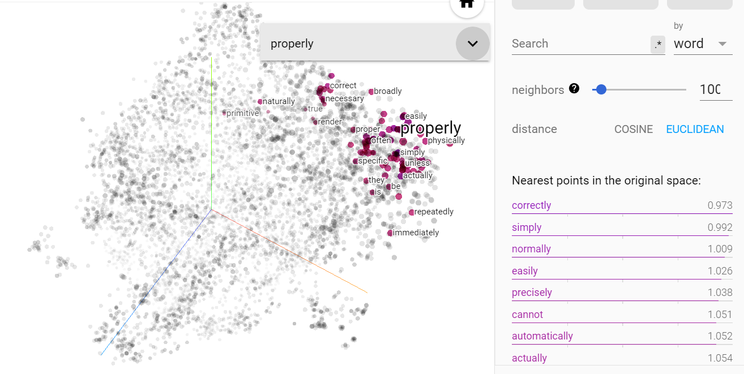
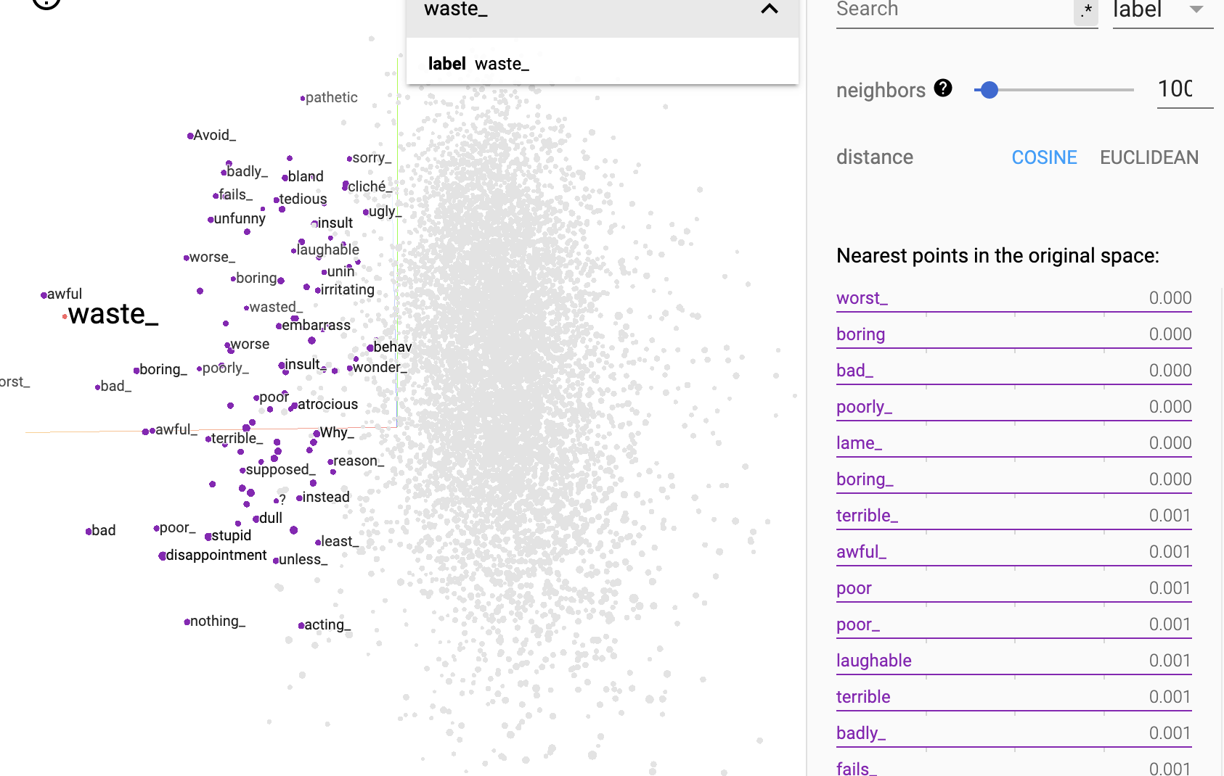
Creating embeddings using the self-supervised approach
Tensorflow offers a plugin that allows you to view embeddings (see the example here https://projector.tensorflow.org/).
You can use this plugin to visualise your own results using the Tensorboard's built-in projector (https://www.tensorflow.org/tensorboard/tensorboard_projector_plugin).

Slide 26
Applications to be carried out
Compare several terms
For a term, find similar terms
Word analogy

Slide 27
4.2
Score prediction
Objectives
Understanding the project and its context
Understanding the benefits of predictive models

Slide 28
Text classification with Tensorflow
Examples
https://www.kaggle.com/code/jeremiahharmsen/tensorflow-hub-for-text-classification
https://github.com/mohamedELBAHA/Text-classification-of-BBC-news-dataset

Slide 29
Error analysis
Display and analyse the observations for which the model was most wrong.

Slide 30
4.3
Model interpretation
Objectives
Themes explaining the level of satisfaction
Keywords/embeddings that explain the level of satisfaction

Slide 31
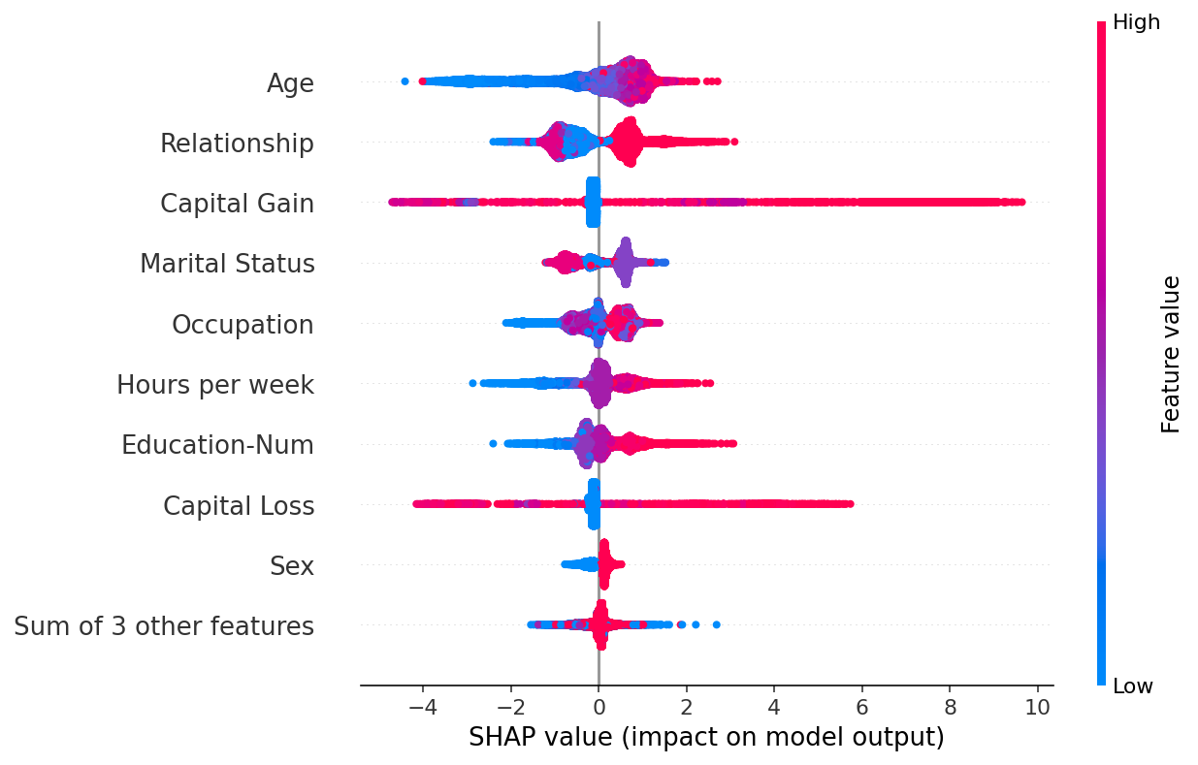
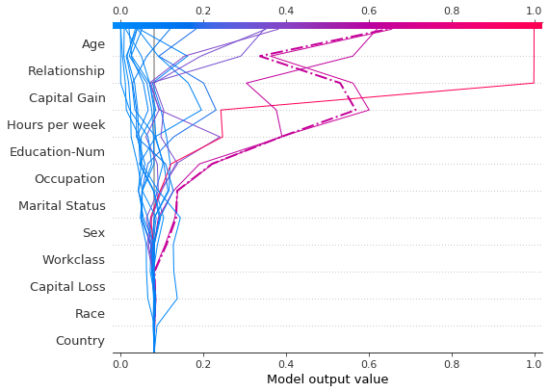
Shap: tabular data

Slide 32
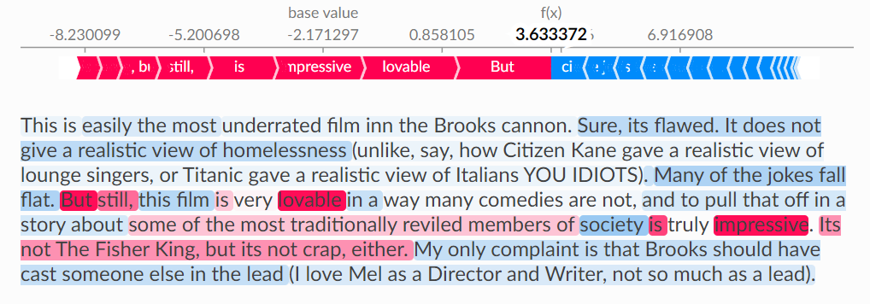
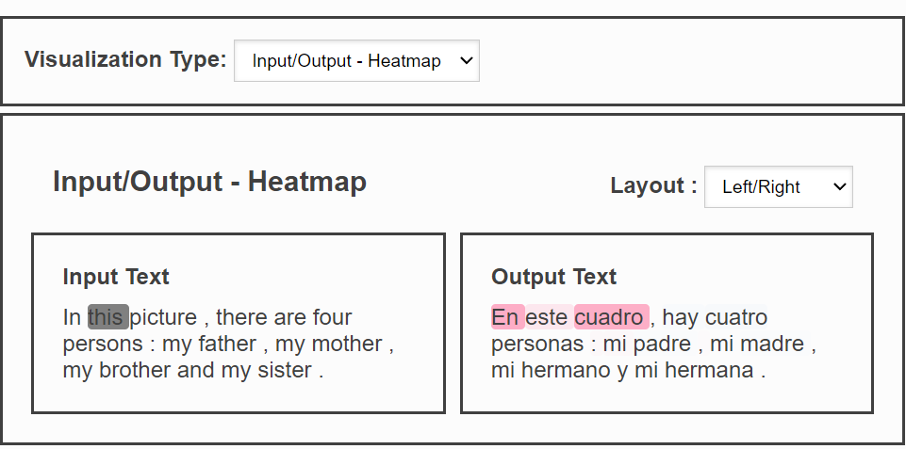
Shap: text plot
https://shap.readthedocs.io/en/latest/example_notebooks/api_examples/plots/text.html

Slide 33
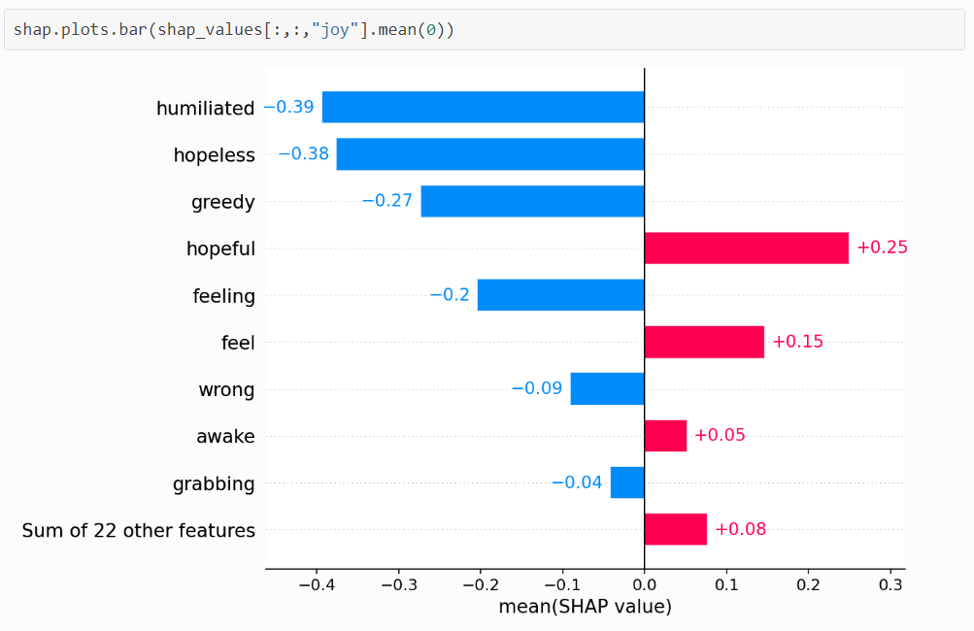
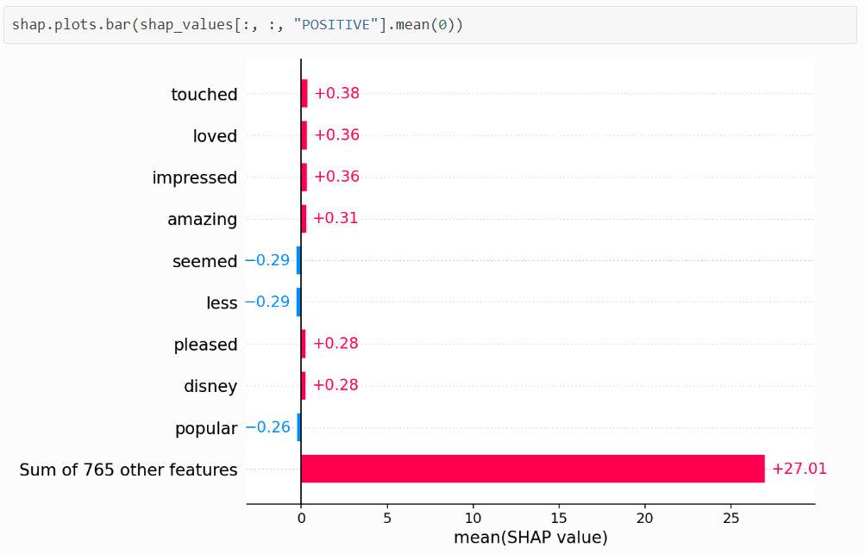
Shap: sentiment analysis
https://shap.readthedocs.io/en/latest/text_examples.html
Notes:
https://shap.readthedocs.io/en/latest/text_examples.html#sentiment-analysis

Slide 34
5
Streamlit applications

Slide 35
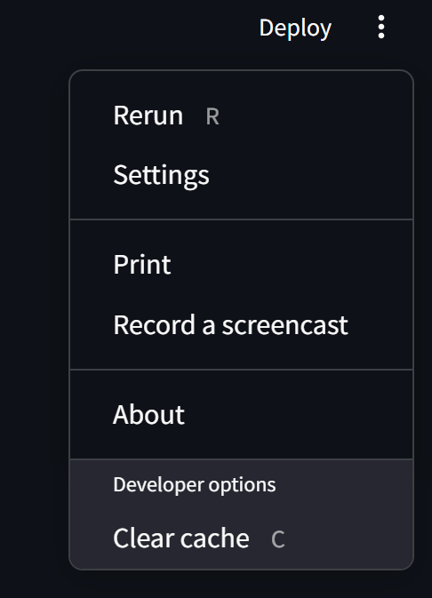

Slide 36
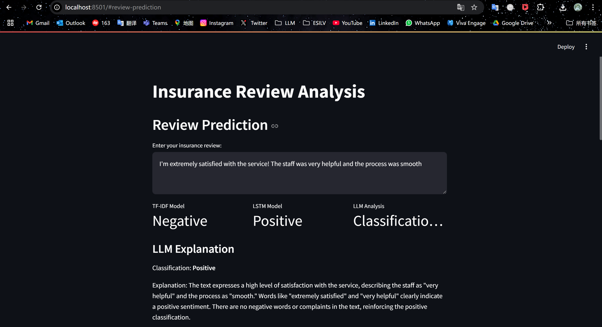

Slide 37
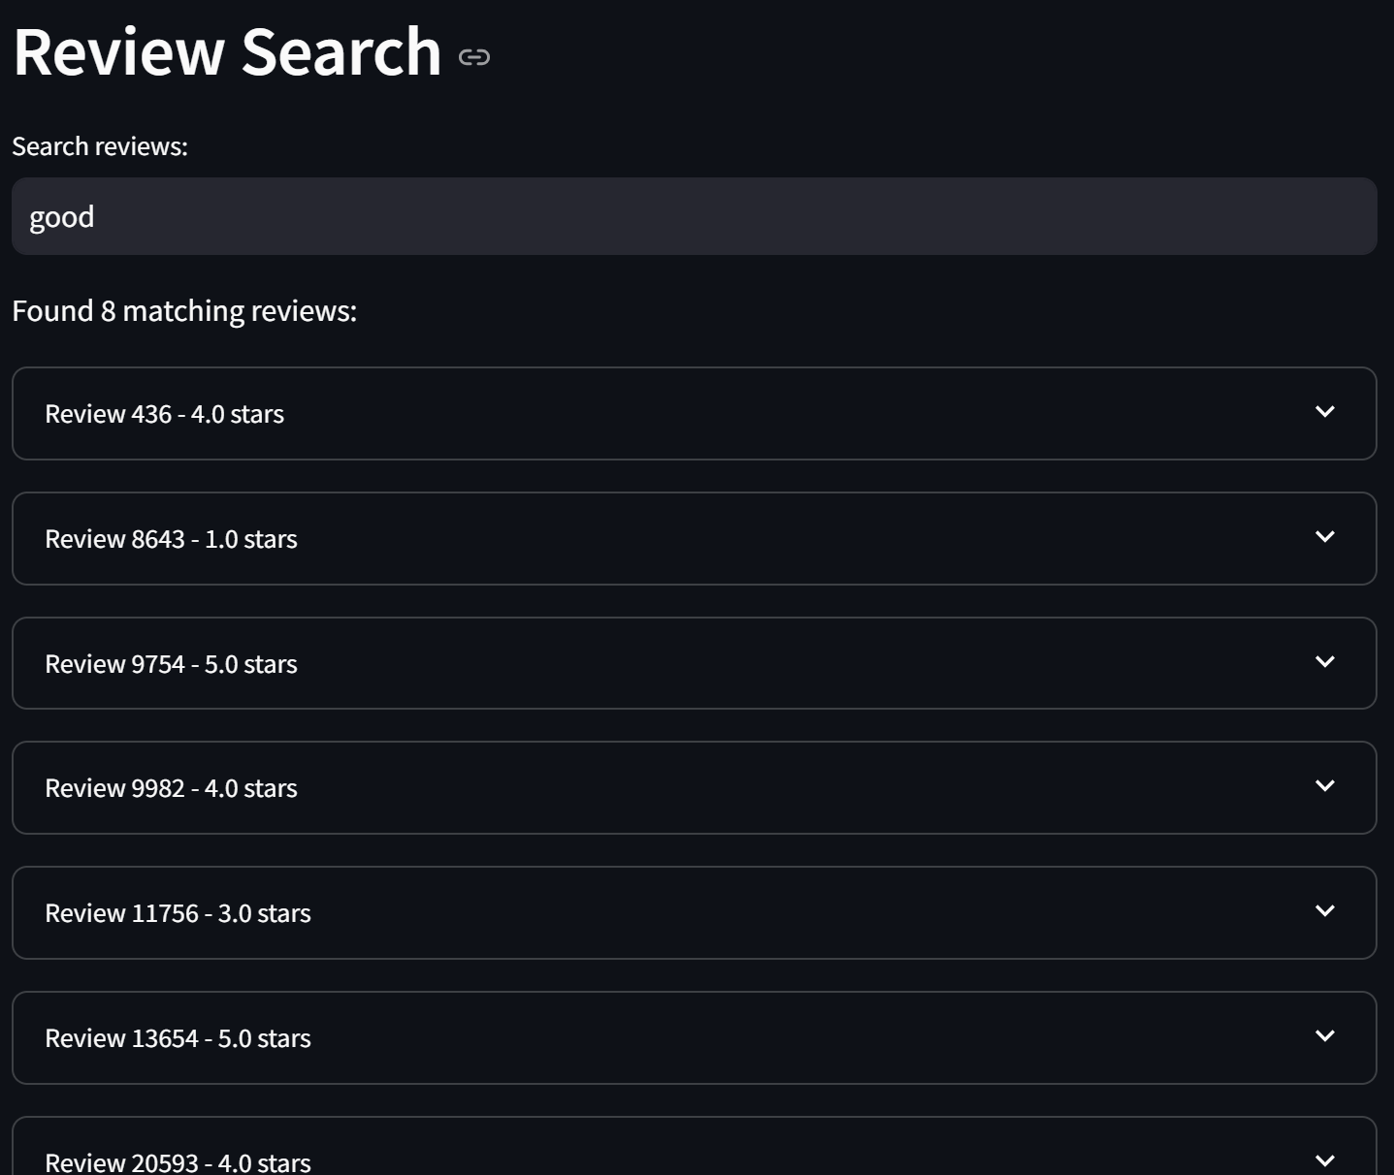

Slide 38
